Slide 1
Western User Group
Welcome!
Made possible by our Strategic Partners

Slide 2
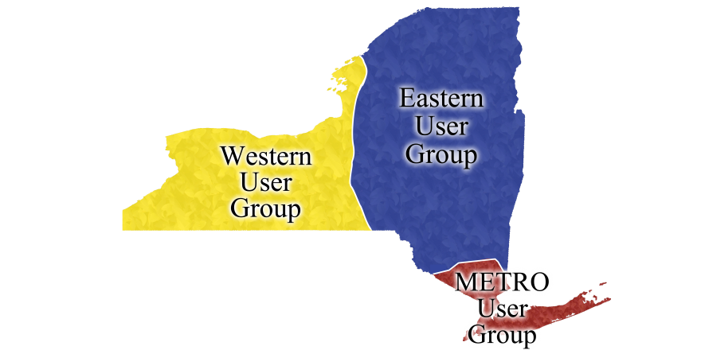
Western User Group Libraries
Alfred Ceramics
Alfred University
Brockport
Buffalo State
Cayuga
Clarkson University
ESF
Corning
Cortland
Erie
Fredonia
Genesee
Geneseo
Hobart & William Smith Colleges
Jefferson
Monroe
Morrisville State College
Nazareth College
Oswego
Potsdam
Rochester Institute of Technology
St. John Fisher College
Syracuse University
Tompkins-Cortland
University at Buffalo
Upstate Medical University

Slide 3
IDS Project (idsproject.org)
Promoting library excellence through community & technology

Slide 4
IDS Annual Conference 2013 August 1st and 2nd Syracuse, NY We are looking for volunteers for the Conference Planning Committee and to help at the Conference.
Please contact Bill Jones @ 585-245-5172, jonesw@geneseo.edu

Slide 5
IDS Annual Conference 2013 Combined Regional User Groups Meeting July 31st , 2013 Syracuse, NY
Do you have a topic you would like to present at the Combined User Group Meeting?
Please contact Micquel Little @ 585-385-7340, mlittle@sjfc.edu

